Slide 1

Manual Wheelchair Maintenance Training
Version 2015-08-14
This training material was supported by the U.S. Department of Health and Human Services, National Institute on Disability Independent Living and Rehabilitation Research (H133A120004). The contents of this manual are solely the responsibility of the authors and do not necessarily represent the official views of the U.S. Department Health and Human Services.
This training material was supported by the U.S. Department of Health and Human Services, National Institute on Disability Independent Living and Rehabilitation Research (H133A120004). The contents of this manual are solely the responsibility of the authors and do not necessarily represent the official views of the U.S. Department Health and Human Services.
This work is protected by the Creative Commons Attribution-NonCommercial-NoDerivs (CC BY-NC-ND) license. For more information, see http://creativecommons.org/licenses/by-nc-nd/3.0/
Notes:
Welcome the wheelchair users and thank them for participating in this training program.
Introduce yourself and your co-trainer if you have one.
Ask participants to introduce themselves.

Slide 2
Wheelchair maintenance training agenda for the next two days.
Day | Duration (minutes) | Time | Activity
1 | 5 |  | Introduction
 | 15 |  | Objectives and relevance
 | 5 |  | How to take care of a wheelchair at home DVD
 | 60 |  | Caring for a wheelchair at home
 | 5 |  | Summary
2 | 90 |  | Hands-on wheelchair maintenance activity
 | 20 |  | Summary and discussion
 | 5 |  | Adjournment
Notes:
Fill in the slide with the appropriate times that are applicable to the training session.
Explain: This is an interactive learning approach to training.
Today, we will watch a video, have a presentation and show examples of how to do maintenance.
In the next session we will do hands-on practice either on your wheelchair or on a demo wheelchair that we have here available.
Remind the participants of the date and time for the next session’s class.
Emphasize that participants are free to ask questions at any time.

Slide 3
We will teach you how to identify problems and how to do basic maintenance.
These two sessions are not intended to be a wheelchair repair clinic.

Slide 4



Interactive wheelchair maintenance training experience with take home resources and reminders.
Maintenance cards
Maintenance reminders
Toolkit
Notes:
Gather: maintenance cards and toolkit.
Emphasize that we are going to use research evidence to provide motivation as to why people should perform more regular maintenance
Explain while demonstrating: at the end of the training you can take home both the maintenance cards for future reference and the toolkit.
Explain: You will also receive reminders to perform maintenance.
We will talk about the reminders in detail later today.

Slide 5
Learning objectives
Recognize the importance of completing wheelchair maintenance
List the appropriate timing for wheelchair maintenance tasks
Demonstrate methods for maintaining your wheelchair
Demonstrate how to identify common technical wheelchair problems
Notes:
Read the learning objectives
Click to highlight the first two objectives
Explain: our goal is to accomplish the first two objectives today and the last two objectives in the second session.

Slide 6

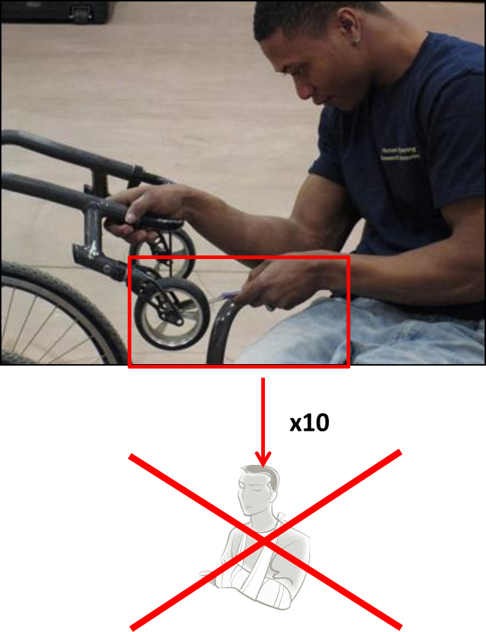
Injuries occur more frequently when wheelchairs are not maintained or repaired.
Notes:
Explain: Between 5 and 18% of wheelchair users in the community experience wheelchair-related injuries each year.
Click so 4 images are highlighted
Explain: This means, of every 20 wheelchair users, between one to four wheelchair users will experience a wheelchair-related injury.
Causes of wheelchair-related injuries include tipping over and wheelchair malfunction among others.
In fact, wheelchairs that are poorly maintained increase the risk of their users being injured due to a wheelchair breakdown.
Wheelchair users who maintain their wheelchair are 10 times less likely to sustain an injury than those who do not maintain it

Slide 7
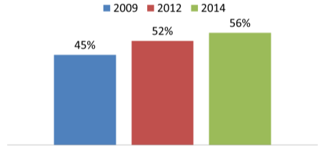
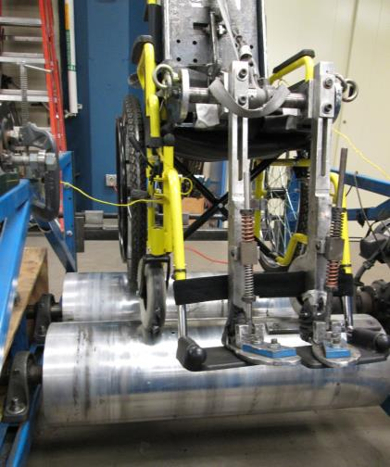

Wheelchair durability found lower than required in laboratory settings and repairs needed increased in the community.
Percentage of wheelchair users reporting needing repairs in the past 6 months
ANSI/RESNA wheelchair double-drum test
Direct wheelchair expenditures annually (Veterans Administration)
Notes:
Explain: It is concerning that the majority of wheelchairs available in the US have been found non-compliant to minimum ANSI/RESA Wheelchair durability standards. This means that many wheelchairs are of lower quality than the expected standards. The image on the left shows an example of durability testing in a laboratory setting. The wheelchair is located on a double-drum device that simulates rolling, much like how cars are tested. The wheelchair is expected to last at least 200,000 cycles which are equivalent to 3-5 years of wheelchair use.
Explain: the wheelchair right caster wheel is broken and shows an example of wheelchair breakdown.
Click to appear the bar chart and pie chart and explain: Research has shown that the number of wheelchair breakdowns reported by wheelchair users in the US has been increasing over time.
From 45% of wheelchair users in 2009 to 56% in 2014.
Explain: These is concerning because breakdowns increase the cost to the health care system. In fact, repairs and replacement costs account for 30% of the direct wheelchair expenditures annually (VA National Prosthetics Patient Database).

Slide 8


Wheelchairs needing repairs has been reported as a cause of adverse consequences for wheelchair users.
Missing work
Missing medical appointments
Being stranded
Being injured
Notes:
Explain: Research has shown that approximately 60% of wheelchair users have reported a needing a wheelchair repair in the previous 6 months.
Click to highlight this proportion and explain: this means 6 out of every 10 wheelchair users.
Click to appear next images on the slide and explain: In addition, one of these 6 wheelchair users that needed repairs, which represents approximately 23% of the 6 wheelchair users will have suffered an adverse consequence such as missing a medical appointment, missing work or school, or being stranded or injured, due to the need for a wheelchair repair.

Slide 9

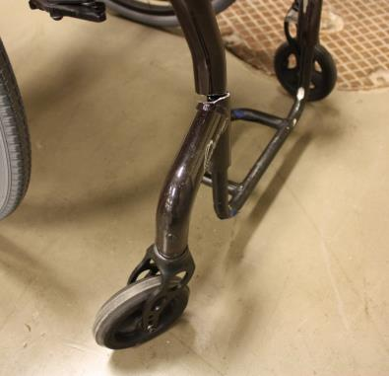
Medicare does not cover maintenance but does cover repairs.
Maintenance such as routine cleaning is not covered.
Necessary repairs are covered.
BE PROACTIVE !!
Wheelchair Maintenance Training
Background Page 9
Notes:
Explain: Because most of the wheelchairs in the US are provided through health insurance, it is important to understand how health insurance relates to wheelchair maintenance and repairs. In the US, many health insurance policies follow Medicare’s coverage.
Emphasize: Routine periodic servicing, such as testing, cleaning, regulating, and checking of the beneficiary’s equipment, is not covered.
Therefore, unless a specific maintenance task is specified by the manufacturer as required to be done by a technician, maintenance is not covered and considered the user’s responsibility.
But, repairs are covered when necessary to make the equipment usable.
Remember, maintenance issues lead to injuries and can be avoided.
Currently insurance coverage does not address them until they become a repairable item (which may be after injury!).
Thus, this maintenance training should help avoid these injuries.
Ask participants: Raise your hand if you know how to contact a wheelchair maintenance expert.
Acknowledge the number of people who raised their hand.
A wheelchair maintenance expert can include the wheelchair vendor, a wheelchair clinic, a wheelchair technician or a wheelchair supplier.
It is important to be proactive! Call your wheelchair maintenance expert right away when you identify problems.
Click to appear the next message on the slide and advice:
If the wheelchair maintenance expert is not compliant, contact your local wheelchair clinic.
They can advocate for you or help you get assessed for a more functional wheelchair.
We strongly encourage you to learn from the wheelchair maintenance expert when they repair your wheelchair. This may teach you further repair skills than what is taught in this basic maintenance course.

Slide 10
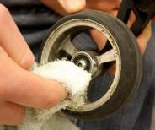
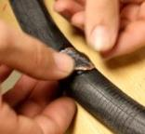
  Wheelchair check-ups are likely to reduce adverse events related to wheelchair breakdowns.
Cleaning caster axles
Patching a flat tire
  All wheelchairs require periodic maintenance to operate properly
Wheelchair Maintenance Training
Background Page 10
Notes:
Explain: All wheelchairs require periodic maintenance to operate properly.
Examples include cleaning the caster axles.
Some wheelchair parts require periodic repair and replacement.
Repair and replacement of components can extend the life of the wheelchair and make using it much easier.
Examples include patching a flat tire.
Much like a car, if a wheelchair is not properly maintained, it can become more difficult to operate, and it will not perform as well as when it was new.
Emphasize: Wheelchair check-ups are likely to reduce adverse events related to wheelchair breakdowns.

Slide 11

Inspection and action items are included in the maintenance schedule.
  No problems
  Continue using the wheelchair
  Inspection
  Found a problem
  Action
  Action
Notes:
Gather: wheelchair and damp rag
Explain: Today we are going to go in detail over the proposed maintenance schedule. The schedule includes inspection and action items.
You will inspect the wheelchair components to check their integrity and proper function. When problems are identified during the inspection they are followed by an action item.
Demonstrate on the wheelchair: an example of an inspection item is to check that the weld points on the frame are intact.
Click to appear next images on the slide and explain: In addition, action items are activities that are performed on the wheelchair.
Demonstrate on the wheelchair: an example of an action item is to wipe down the wheelchair frame.
Explain: Another way of understanding the difference between inspection and action is an inspection is looking for a problem and an action is trying to fix the problem. For example, an inspection item for your car is to check the gas level and an action item is to fill it up with gas if the level is close to empty.

Slide 12
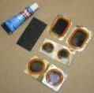



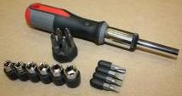

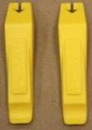


The toolkit provided contains the tools needed to perform basic inspection and action maintenance items.
Tire patch kit
Crescent wrench
Lubricant
Screwdrivers
Tire pump
Tire lever
Combination wrench
Allen wrenches
Wheelchair Maintenance Training
Overview Page 12
Notes:
Gather: tool kit
Explain: As mentioned at the beginning, each one of you is receiving a toolkit that has basic tools for maintenance. The toolkit has the following tools:
Invite participants to open the toolkit and identify the tools that you are naming.
Show each tool from one of the toolkits as you explain them.
Demonstrate on the wheelchair while you explain each tool.
Explain:
1. Screwdriver: is a tool for turning screws. Always use a screwdriver tip that properly fits the slot of the screw. Your toolkit has a multi bit screwdriver with different tips that will fit the slots of the screws that we see on the slide.
2. Allen wrench: is a tool for turning screws that have a hexagonal socket in the head (point to image on slide). Always use the correct size needed for the job, as using an Allen wrench on a socket that is too large may result in rounding the socket. Which means that the Allen wrench in the future would not be able to grab a hold of the socket. You have in your toolkit both standard and metric Allen wrenches.
3. Open-end box-end wrench combination tool or Crescent wrench: are tools to turn nuts and bolts or keep them from turning while tightening them. Be sure to use the proper size wrench, and only use adjustable wrenches when you do not have the proper size. An adjustable wrench may cause bolts or nuts to round off if not used correctly.
4. Plastic tire lever: Use to remove a pneumatic tire. We will see how to use this later in this session.
5. Tire patch kit: used to patch a flat inner tube. It contains a scratching tool, glue, and patches. We will see later how to use it.
6. Tire pump and gauge: A foot pump, compressor or high pressure hand pump is necessary to inflate tires over 50psi. Tires can also be filled using gas station airlines, but a valve adaptor may need to be used. Emphasize: the pump is not provided with this toolkit.
7. WD40: lubricates and protects against corrosion. It also removes grease, gum, dirt, & scuff marks.
Show the maintenance cards and you explain: in addition, in the tool case, you will have a set of maintenance cards that you can use to remind you of the maintenance tasks and how often to perform them. We encourage you to store the maintenance cards with the toolkit.

Slide 13
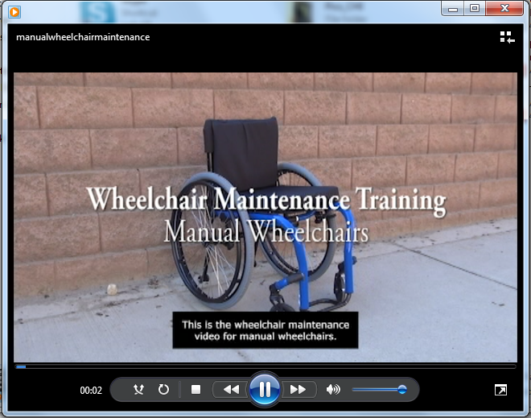
How to take care of a manual wheelchair at home.
Wheelchair Maintenance Training: Manual Wheelchair
Video Page 13
Notes:
Explain: We are going to watch a video that summarizes all the inspection and action items that we are going to learn today and practicing in the next session.
Play the file manualwheelchairmaintenance.wmv

Slide 14


When transferring out of the wheelchair to do maintenance, always sit on a stable and protected surface.
Notes:
Explain: Before starting, remember, when transferring out of the wheelchair to do maintenance, always sit on a stable and protected surface.
In the example image in the slide, the person is sitting on his own cushion on a stable chair while pumping a tire.

Slide 15
  Inspection items are activities that the wheelchair user or caregiver performs to check items on their wheelchair.
Inspection items
  No problems
  Continue using the wheelchair
  Inspection
  Found a problem
  Action
Wheelchair Maintenance Training: Manual Wheelchair
Maintenance at Home Page 15
Notes:
Explain: Now we are going to go over in detail each maintenance activity.
We will start with the inspection items.
You will inspect the wheelchair components to check their integrity and proper function. When problems are identified during the inspection they are followed by an action item.

Slide 16
Some inspections should be done weekly,
though most should be done monthly.
Inspection items
Rear wheels | Tire Bearings Spokes Alignment Quick-release mechanism Locks Handrim
Casters | Bearings Anti-tip
Cushion | Cover
Supports | Arm Foot Back Upholstery Clothing guard
Frame | Welds Cross-brace Suspension
Weekly inspections
Nuts and bolts
Wheelchair Maintenance Training: Manual Wheelchair
Maintenance at Home Page 16
Notes:
Read the summary of the inspection items and explain: We will go over in detail on how to complete each inspection item and what to do if problems are identified.
Orange highlights the inspections that are done weekly. The rest are done monthly.

Slide 17
Pneumatic tires
Weekly Inspections

Slide 18







Improperly inflated tires wear quickly and
make a wheelchair difficult to maneuver and propel.
Pneumatic tires
5mm
Tire depresses more than 5mm
Inflate
Types of valves
Presta
Schrader
Inflate to recommended pressure
INSPECT WEEKLY
Wheelchair Maintenance Training: Manual Wheelchair
Notes:
Gather: wheelchair with flat tire and a tire pump. You can have adaptor valves for participants to try.
Explain: If you have pneumatic tires, properly inflated tires are important for wheelchair propulsion. If the tire lacks sufficient pressure, the wheelchair will be difficult to maneuver, propulsion will take more energy and it will stress the shoulders more. The tire and wheel will also wear much more quickly when the tire is not properly inflated.
Demonstrate propelling with a flat/underinflated tire.
Demonstrate how to inspect while explaining:
Check the pressure by pressing down firmly on the tire with your thumb.
2. If the tire presses down more than 5mm (roughly the thickness of three pennies stacked together), the tire needs to be inflated.
3. Add air to the tire using a bike pump, compressor, CO2 cartridge.
Emphasize: Do not use a gas station air hose. Wheelchair tires have very small volume and it is very easy to explode a tire.
Point out the type of valve that the demonstration wheelchair has while explaining: There are two types of valves used for pneumatic tires on wheelchairs: presta valves and schrader valves. Make sure your air pump has the correct type of valve for your wheelchair.
Ask: How much should you inflate the tire?
Acknowledge answers
Click to show the next pictures on the slide and explain: It is recommended to inflate to pressure indicated on tire.
Demonstrate pumping the tire, mention the suggested pressure on the tire and inflate.
Discuss: People’s answers may be variable depending on type of tire (e.g. “road” vs “mountain” and size) and ride preference (“comfort” at low pressure, “performance” at higher pressure).
Ask: How often should you check the tire pressure?
Acknowledge answers
Click to appear the recommended frequency and explain: We recommend checking the tire pneumatic pressure weekly and to check it more often during winter.

Slide 19



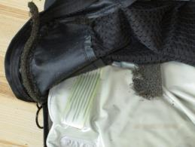
Deterioration in the cushion can increase the risk of developing a pressure ulcer.
Hole on cushion cover
Inspect cushion cover
Open the cover and inspect cushion
Cover foam liner flaking
Wheelchair Maintenance Training: Manual Wheelchair
INSPECT WEEKLY
Notes:
Gather: different type of cushions, e.g. foam, gel, air, etc.
Explain: Cushions are a very important component of the wheelchair AND
Cushions do not last as long as the frame.
The interaction between the cushion and the body determines the user’s comfort, function, and clinical safety.
Deterioration in the cushion can increase the risk of developing a pressure ulcer.
Explain while demonstrating: Remove the cover so you can inspect both cushion and cover.
That means that you must be out of the wheelchair.
Look for tears or holes in the cover or zipper malfunction, which might expose the cushion surface or create a wrinkled sitting surface.
The cushion cover on the top right of the slide has a hole.
If the cover contains a foam liner, look for tears or flaking in the foam.
The cushion on the bottom right has flaking in the foam liner of the cover.
The bottom of most covers has a Velcro or a nonskid surface.
Inspect this surface for worn or torn Velcro or breakdown of the nonskid material.
The cover is designed to protect the cushion, so it should be replaced if damaged.
After inspecting the cover inspect the cushion for shape and contour.

Slide 20






Inspection of the cushion condition may vary depending on the type of cushion.
Cushion and Cover
Air cushions
Gel cushions
Foam cushion
Remove cover to inspect cushion
Wheelchair Maintenance Training: Manual Wheelchair
INSPECT WEEKLY
Maintenance at Home Page 20
Notes:
Explain: There are many types of cushions.
Depending of the type there are signs you should look for.
We are going to discuss some examples.
Explain while demonstration (if you have that type of cushion available):
If your cushion is air: Keep the cushion properly inflated.
Inspect that the valve is in good condition and does not leak.
If you suspect that there is a leak, remove the cover and submerge the cushion in water and look for bubbles.
A rubber air cushion (e.g. ROHO) can be patched using the same procedure we saw for patching a tire.
ASK: Those of you who are using ROHO’S, do you have the patching kits that came with the cushion?
Acknowledge answers.
Note: When you travel by air pay special attention to the cushion because the pressure will change. Always travel with a patch kit.
Click to appear the next images on the slide and explain:
If you have a gel cushion, knead the gel daily so it moves under bony prominences.
Inspect that the gel is not hard and also there are no leaks.
An example of a worn out cushion can be seen on the left with the blue gel that is leaking.
Click to appear the next image on the slide and explain:
If you have a foam cushion, inspect that the foam is intact and not deteriorated and chipping.
When you press it, it should bounce back.
Explain: If the cushion has a solid seat insert, check that it is not broken.
Emphasize and show on the cushion you are holding:
Be aware of the direction of the cushion.
After inspecting, place the cushion properly back on the wheelchair.
Explain: This task should be performed weekly and if problems are identified a wheelchair maintenance expert must be contacted immediately to get the cushion replaced. If a cushion is not replaced it may lead to unwanted consequences such as pressure sores.

Slide 21
Pneumatic tires
Monthly Inspections

Slide 22
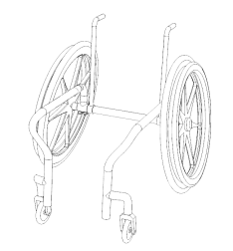
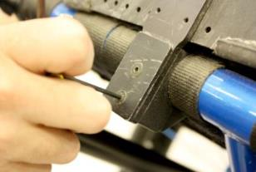
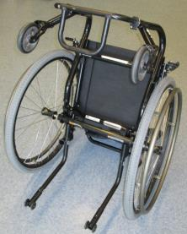

Nuts and bolts that are too loose may cause parts to rattle, fall off, and even lead to a malfunction.
Nuts and Bolts
If bolts are visually loose or parts rattle...
…Tighten appropriately
Common nut/bolt locations
INSPECT MONTHLY
Notes:
Gather: Wheelchair with loose clothing guard, Show examples of bolts and tools to use to tighten. Show an example of a lock nut.
Explain: Most maintenance consists of ensuring that nuts and bolts are properly adjusted. Inspecting nuts and bolts should be done while you inspect different parts as we will see throughout the presentation. Nuts and bolts that are too loose will loosen further or not hold the part properly.
Demonstrate while describing. Visually identify loose bolts. Move parts and check that they do not rattle. Tighten all loose nuts and bolts until snug. Depending on the bolt, you can use a screwdriver, wrench or Allen wrench. Tighten to the point where the parts that the nuts and bolts are holding do not move at all. Do not over tighten! Clamps are meant to be very tight. Tighten as much as reasonably possible with the appropriate tool. Moving parts, such as the wheel lock mechanism, should be snug but not particularly tight. These often use locknuts. Over tightening a loose nut or bolt could damage the part and/or bolt.
Bolts are graded for strength and hardness. The specific grade is selected by the manufacturer for the part where the bolt is to be used. Bolts used on wheelchairs must be replaced with the proper size and type bolt.
Emphasize: If nuts or bolts are missing, stripped or broken, contact a wheelchair maintenance expert to get the bolts/nuts replaced.
This task should be performed monthly.

Slide 23


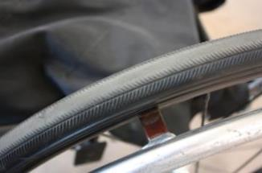

Worn out tires make the wheelchair more difficult to propel and could lose air and/or burst.
Rear tires
Inspection
Types of Tires
Pneumatic
Checking for wear
Solid (no valve)
Intact (green) and wore out (red) tread
Wheelchair Maintenance Training: Manual Wheelchair
INSPECT MONTHLY
Maintenance at Home Page 23
Notes:
Gather: wheelchair with worn out tires.
Explain: The wheels have a significant effect on the performance of the wheelchair.
Worn out tires can make the wheelchair harder to propel.
Explain while indicating what type of tire you have in your sample wheelchair:
Rear tires can be pneumatic tires or solid.
You can determine what type of tire do you have by looking at the rim where the air valve sticks out.
If there is no valve your tire is solid. If there is a valve you have a pneumatic tire.
Demonstrate while explaining: Visually inspect the rear tires for wear, cracks, bulges, looseness, damage, and flat spots. Note in the lower right picture the green arrow points to intact thread and the red arrow points to worn out threads.
Contact a wheelchair maintenance expert to replace tires when the tread becomes worn, cracked, loose or when the side walls begin to bulge out when pumped with air.
Emphasize: In solid tires, it can be hard to see a flat spot on the tire. Usually, you will feel it when rolling on a flat and smooth surface.
Ask: how often show this inspection be performed?
Acknowledge participants answers.
Answer: This task should be performed at least monthly.
Ask: From your experience, how often do you usually get your tires replaced?
Acknowledge answers

Slide 24
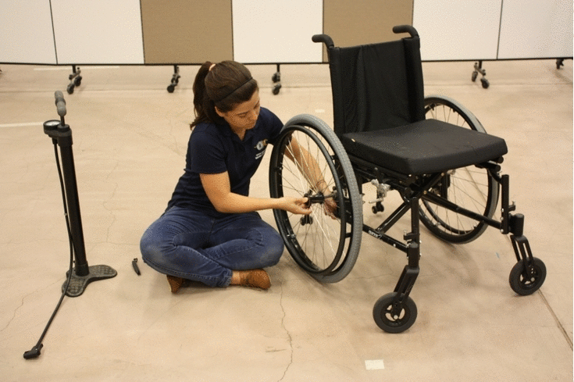
A damaged inner tube will not hold air and should be replaced or patched.
Notes:
Gather: a wheelchair with a flat tire.
Explain: If you pump your tire and it goes flat right away you may have a hole in the tube.
Show participants the levers and patches from one of the toolkits and explain:
You can patch it with the patch kit in your toolkit or replace the inner tube for a new one.
You will need two plastic tire levers to remove the tube.
Click to appear the animated image and explain while animation runs:
1. Release the air left in the tube
2. Release the wheel and place on a flat, level surface.
3. Pry off the tire with the plastic tire lever by bending back slightly the edge of the tire where it meets the rim
4. Use the second tire lever to loosen the tire from the rim
5. Pull out the inner tube, starting with the section opposite the valves and ending with carefully removing the valve last.
6. You will either patch or replace the tube.
7. Take the tube and place the inner side into the rim trench of the wheel, starting by carefully placing the valve through the hole on the rim.
Tip: Inflating the tube a little makes it easier to put on.
8. Stretch the tube around the rim.
Tip: A little liquid dish soap can make it easier to put a tire on.
9. Let all the air out before fully inflating to help remove the kinks.
10. Pump the tube to the required pressure.
Explain:
Next session during the hands-on activity we will practice.

Slide 25

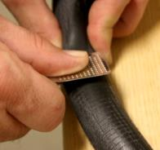
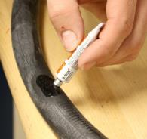


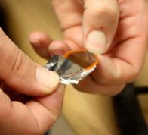

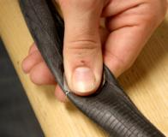
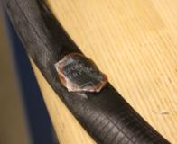

Many inner tube punctures can be fixed with a patch.
Pneumatic Tires: patching a tube
Patch kit
Patching an inner tube
Finding the puncture
1
2
3
4
Inflate
Submerge
5
6
Bubbles
Wheelchair Maintenance Training: Manual Wheelchair
Maintenance at Home Page 25
Notes:
Gather: Flat inner tube, patch kit, pump, permanent marker bucket with water
Show the materials as you explain: To patch the tube you will need a bucket partially full of water and the tire patch kit.
Demonstrate as you describe the steps:
1. After removing the inner tube, to identify where you have the puncture by pumping up the tube until full and submerge the tube underwater.
2. The part of the tube that bubbles is where the hole is located.
3. Mark the position of the hole with a pen or marker.
4. Dry off the tube and gently scratch the area around the hole with the scratching tool.
5. Apply the glue all around the area of the hole
6. Affix the patch.
7. Press down on the patch firmly for about a minute to make sure it stays on.
8. Put the tube back into the tire.

Slide 26




Damaged bearings make the wheelchair more difficult to maneuver and propel.
Rear wheel bearings
Close up view of wheel bearing
Testing
Lift one side
Spin the wheel
Wheelchair Maintenance Training: Manual Wheelchair
INSPECT MONTHLY
Notes:
Gather: damage bearing or caster with a damaged bearing.
Explain: The wheel bearings allow for free rotation of the wheel around the wheel axis.
Therefore, damaged bearings can increase rolling resistance which will make you spend more energy and stress your shoulders more while propelling.
Bearings will wear out on a wheelchair during normal use.
Noise is the first thing that will alert you about a wheel bearing that is failing.
Most prominently, a knocking noise, and on some occasions, a squeaky squealing moan is what would be the first indicator of such a problem.
Initially, the sound would be heard only at certain speeds, but will become fairly regular and prominent as the condition of the bearings worsen.
Pass around the broken bearing example.
Demonstrate while describing: Inspect that the bearings are working properly.
Lift one side of the wheelchair off the ground, and spin the wheel, letting it rotate to a stop.
If the wheel slows and stops quickly, the nut and bolt holding the bearing could be too tight.
If the wheel slows and rotates backwards slightly when spun, the bearing is not being compressed and it could be too loose.
Repeat the same procedure with the other wheel.
Emphasize: If problems are identified, contact a wheelchair maintenance expert to get the bearings replaced.
Recommend: This inspection should be performed monthly.

Slide 27


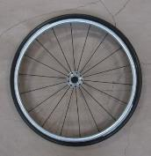

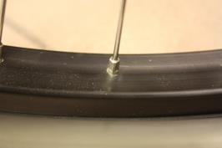
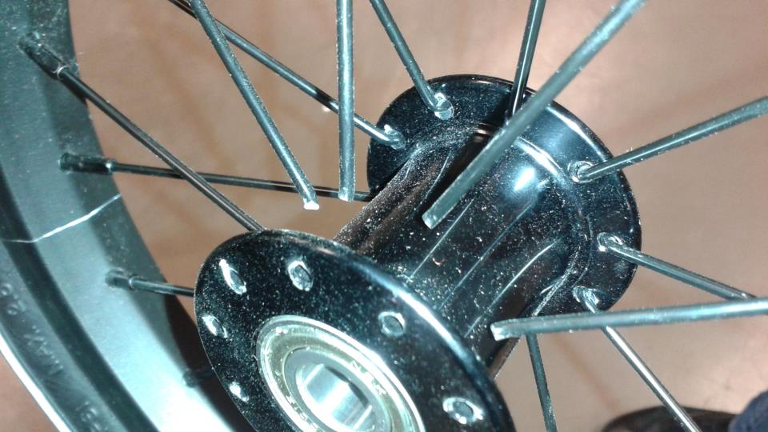
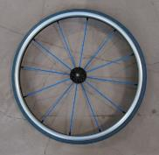
Loose or damaged spokes can make propulsion more difficult or even cause the wheel to collapse.
Wheel Spokes
Wheels with different spokes
Test spokes by squeezing every two together
Spoke nipple
Broken spokes
Wheelchair Maintenance Training: Manual Wheelchair
INSPECT MONTHLY
Maintenance at home Page 27
Notes:
Gather: wheel with a loose spoke.
Through use, spokes can become loosened, damaged, or broken. The spokes should all have equal tension. One loose spoke will cause the others to carry more tension. Ultimately the wheel will go out of round. Emphasize: spokes have domino effect. If there is only one loose, others will follow it very quickly. Loose spokes can make the wheelchair harder to propel and/or cause the wheel to collapse. If spoke tension is unequal, you may hear a faint, metallic, snapping sound as you move.
Demonstrate while describing: Inspect the spokes monthly by squeezing two together all the way around the wheel. If a spoke “gives” when you squeeze gently, it may be too loose. Inspect that the spokes are not bent. Inspect that the nipples are tight, not bent or nicked.
SHOW THE EXAMPLE OF LOOSE SPOKE(S)
Ask: What should you do if you find loose spokes?
Answer: If problems are identified, contact a wheelchair maintenance expert. It is recommended that you do not do this on your own because spokes must be tensioned to a specific torque range and a special stand is used to do this. Otherwise, spokes or their nipples could break and the wheel could go out of true (how much it wobbles from side to side). A bicycle store/shop is useful to get spokes tightened if you have pneumatic tires. If you have solid tires, you need to contact the wheelchair maintenance expert since a new wheel might be the best solution.

Slide 28




If a wheelchair’s wheels are not aligned, it will force the wheelchair user to push more often to travel straight.
Wheel Alignment
Testing alignment with water
Roll through water
Coast, leaving tracks
Alignment (top view)
Alignment (front view)
INSPECT MONTHLY
Wheelchair Maintenance Training: Manual Wheelchair
Maintenance at Home Page 28
Notes:
Gather: Wheelchair misaligned.
Explain: Wheel alignment describes the degree to which the rear wheels are parallel to each other and parallel with the centerline of the wheelchair. Tracking is important as the user pushes on the handrims very frequent about once a second. If the wheelchair does not track well, it will drift from its course between pushes and forces the wheelchair user to push more often with one arm than the other to travel straight. This will increase strain on one arm, waste energy, and reduce control over the wheelchair.
Demonstrate pushing a misaligned wheelchair (if possible) while explaining:
Wheelchair users learn how the wheelchair “feels” so they can identify misalignment.
The wheelchair should roll straight with no excess drag, pull or side motion.
It should not be difficult to push and you should not hear wheel rubbing.
When turning, there should be no squeaking, binding, or excessive side motion.
Explain: Tracking can be checked by rolling through a puddle of water and allowing the wheelchair to coast.
The wheelchair should maintain its direction.
If problems are identified, contact a wheelchair maintenance expert.
This task should be performed monthly.

Slide 29



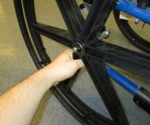

Wheel axles that are not properly tighten or latched can come off and lead to an accident.
Inspection
Type of axles
Quick-release axle
Fixed axle
Wheelchair Maintenance Training: Manual Wheelchair
INSPECT MONTHLY
Maintenance at Home Page 29
Notes:
Gather: wheelchair with quick release wheel and an example of a quad quick release lever if possible.
Explain: Wheel axles can be removable (commonly known as quick-release) or fixed.
Demonstrate while explaining: hold the wheel from the hub and wiggle in all directions.
If the wheel is fixed, it should not have play.
If the wheel is quick-release some play is acceptable.
Demonstrate while explaining: Check that the quick-release mechanism functions properly. The axles should slide through the wheel housing smoothly and click and latch into place.
Wheels that do not latch securely can come off and lead to an accident.
If the axle does not latch properly contact a wheelchair maintenance expert immediately.
Ask: how often do you remove the wheels? For example to transfer in/out a car?
Acknowledge answers
Emphasize: If you remove the wheels often be aware every time you do so that it is functioning properly.
If you do not remove the wheels often this inspection should be performed monthly.

Slide 30



Malfunctioning wheel locks can be dangerous during transfers.
Wheel Locks
Testing wheel locks
Wheelchair Maintenance Training: Manual Wheelchair
INSPECT MONTHLY
Maintenance at Home Page 30
Notes:
Gather: Wheelchair with loose lock
Explain: Wheel locks act as parking brakes and assist when transferring to other surfaces, or when rider wishes to remain in a particular spot.
They allow the rider to push things and to be more stable when desired, such as when lifting or pushing things or even simply sitting still. There are many different types of wheel locks.
Demonstrate while describing: Inspect that the wheel lock is working properly.
First inspect that the wheel locks are secured tightly to the frame.
Apply the lock and check that it holds the tires firmly in place.
Note that they are easily activated and that the wheel locks do not interfere with the tire while rolling.
Wheel locks that interfere with normal wheel rolling cause wear to the tire and brake.
Emphasize: if pneumatic, tires must be inflated properly for the brakes to work.
This task should be performed monthly.

Slide 31







Wheel locks should be adjusted if they do not work or interfere with the wheel.
Wheel Locks: adjustment
Loosen
Adjust
Tighten
Wheelchair Maintenance Training: Manual Wheelchair
Maintenance at Home Page 31
Notes:
Gather: allen wrench and open wrench.
Demonstrate while explaining: If you find any problem while inspecting the wheel locks:
Adjust wheel locks if they are loose or not working properly.
Use an open-box wrench and/or Allen wrench to adjust as necessary.
Note the wheel lock on the slide is adjusted using an Allen wrench.
If the locks still do not work properly, contact the wheelchair maintenance expert.

Slide 32


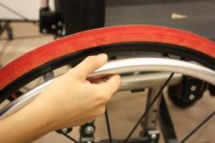
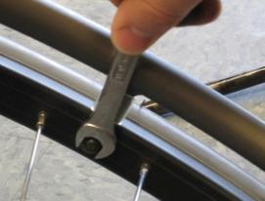
Loose handrims, or handrims that have sharp edges could be hazardous to the user.
Inspect for wear
Handrim with scratches
Inspect tightness
Tighten as necessary
INSPECT MONTHLY
Notes:
Gather: Wheel with loose handrim
Explain: Handrims are metal or plastic rings that are attached to the rear wheels and used to propel a manual wheelchair.
Demonstrate while explaining: Inspect the handrims for wear, dents, or bends.
Cracks can cut or harm the user.
Contact a wheelchair maintenance expert to have the handrim replaced.
Demonstrate while explaining: Inspect if they are loose.
You can feel that they are loose while you propel.
A loose handrim can make it more difficult to grasp and may fall off.
You can tighten the handrim using an open-end wrench or a screwdriver.
If unable to do so contact the wheelchair maintenance expert.
This inspection should be performed monthly.

Slide 33

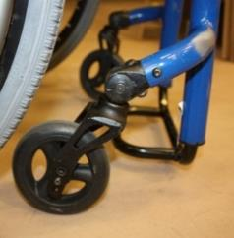
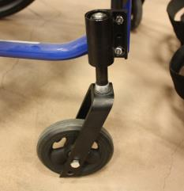

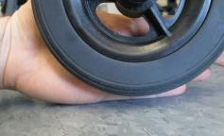
Casters that are worn out or caster stems not vertically aligned can make the wheelchair harder to propel.
Example of possible problems
Caster assembly
Not vertically aligned
Missing caster assembly cap
Caster float
Inspect for wear
INSPECT MONTHLY
Wheelchair Maintenance Training: Manual Wheelchair
Notes:
Gather: wheelchair with caster float if possible
Explain: The caster wheels have an important effect on the performance of the wheelchair. Worn out caster wheels can make the wheelchair harder to propel.
Demonstrate while describing: Inspect casters wheels for wear, cracks, looseness, bulges, and tears.
Inspect that the casters wheels are evenly touching the floor when on a flat surface.
When one of the casters wheels does not touch the floor while on level ground, the wheelchair has caster float.
This decreases the stability and performance of the wheelchair.
Inspect that the caster stem housing is aligned vertically.
If you find problems contact the wheelchair maintenance expert.
Inspect the front caster caps; these caps protect the caster assembly from moisture and water.
If they come off, contact the wheelchair maintenance expert.
This task should be performed monthly.

Slide 34
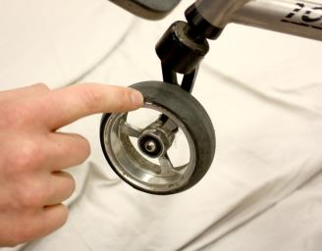
Caster wheels must spin and swivel freely, worn out bearings can make the wheelchair difficult to maneuver.
Spin both the caster (wheel) and caster assembly
INSPECT MONTHLY
Notes:
Gather: wheelchair with damaged caster bearing.
Explain: Like in the rear wheels, the caster bearings allow for free rotation of the wheel around the wheel axis.
In addition, casters have another bearing that allows for shaft rotation.
Bearings will wear out on a wheelchair during normal use.
Wore out bearing can make the wheelchair difficult to maneuver.
Demonstrate while describing: Inspect the caster bearings by checking that they spin and that they are tight.
Spin the caster and the caster assembly.
To check caster bearings push the caster side to side.
You should feel if there is any grinding.
Inspect that there is no excessive play in the caster axle.
Emphasize if problems are identified, contact a wheelchair maintenance expert to get the bearing replaced.
Learning how to replace a bearing is out of the scope of this training program. However, we encourage you to learn from the wheelchair maintenance expert how to replace it.
We recommend to inspect the bearings monthly.

Slide 35
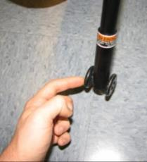



Malfunctioning anti-tip casters can increase the risk of a tipping accident.
Turning the caster wheels
Height difference
Side view
Inspect they latch properly
Inspect they are adjusted evenly
INSPECT MONTHLY
Notes:
Gather: Wheelchair with anti-tippers.
Explain: Anti-tip casters may be used on the front and rear of a wheelchair.
When rear anti-tip casters are in use and properly adjusted, if the wheelchair begins to tip over the rear anti-tip casters resist the tipping.
Therefore, they can help to prevent some tipping accidents.
Demonstrate while describing. Inspect that the pins work, that they can be put on and off, and that the rollers are not broken.
If problems are identified, contact the wheelchair maintenance expert to have the anti-tip casters replaced.
If anti-tippers are present, inspect them monthly.

Slide 36
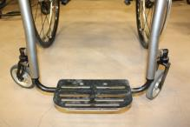

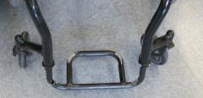
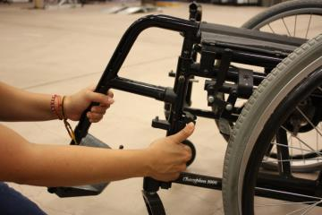
Loose foot supports can rattle, fall off, or even malfunction.
Rigid foot support
Flip up foot support
Rigid foot support with a crack
Swing away foot support
Wheelchair Maintenance Training: Manual Wheelchair
INSPECT MONTHLY
Maintenance at Home Page 36
Notes:
Gather: Wheelchair with rigid frame and rigid foot support as well as a wheelchair with loose swing-away foot support.
Explain:
Foot supports are used to support the feet and legs.
Often the foot supports are the first part of the wheelchair to come in contact with an obstacle.
They are used to open doors, act as bumpers, and are often scraped along the ground when the wheelchair is loaded into a motor vehicle or during mobility techniques such as wheelies, curb cuts, and sharp inclination changes such as the end of ramps.
Cross-brace-frame wheelchairs typically have foot supports that can flip up or down, swivel, are angle-adjustable, or can be removed, whereas rigid-frame wheelchairs have the foot support built into the frame.
Rigid foot supports are normally are not removable, but the height often can be slightly adjusted to accommodate various leg lengths [18].
Swing-away foot support are not as durable as rigid foot support [18].
Point out the different foot supports in participants’ wheelchairs.
Demonstrate while describing:
Inspect that the foot supports are intact, tightened and can be released (if originally designed to do so), put back into place with ease and that they latch properly.
Inspect the swing away foot support, look for wear in the pin, bolt and bushing in this mechanism.
You can use a screwdriver, wrench or Allen wrench to tighten loose bolts.
If problems are identified, contact the wheelchair maintenance expert.
This task should be performed monthly.

Slide 37






Loose arm supports can put the user at risk for falls when using them for support during transfers.
Removable arm support
Flip-up arm support
Wheelchair Maintenance Training: Manual Wheelchair
INSPECT MONTHLY
Maintenance at Home Page 37
Notes:
Gather: Wheelchair with a damaged armrest, especially loose and/or worn out.
Explain: The primary purpose of the arm support is to provide good resting posture for the arms.
In addition, arm supports provide a form of support and are convenient handles when the rider leans to one side or the other.
They are also helpful when attempting to reach higher places, and they also assist some people with transfers.
Explain while demonstration with the demo wheelchair and pointing at participants wheelchairs:
Arm supports can be fixed or adjustable.
Most can be removed or flipped out of the way in order to provide clearance for transferring in and out of the wheelchair.
Removable arm supports usually fit into one or two sockets.
Commonly, if there are two attachment points, the front socket contains a latch to lock the armrest in place.
Flip back arm supports are hinged at the back near the intersection of the seat and backrest.
Some flip back supports use the latch in the front to help secure them in place.
Demonstrate while describing: Inspect that the arm supports are intact, tightened and can be released (if originally designed to do so), put back into place with ease, and latch easily.
Inspect for sharp edges that could cause harm.
Loose arm supports can make the user fall when using them for support during transfers.
Tighten as necessary.
If a problem is identified, contact the wheelchair maintenance expert.
This inspection should be performed monthly.

Slide 38




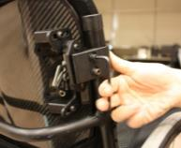
A deteriorated back support can encourage improper back posture.
Types of back supports
Rigid backrest
Contoured backrest
Adjustable tension
If loose…
Inspect back posts and back support hardware
…Tightening hardware
Wheelchair Maintenance Training: Manual Wheelchair
INSPECT MONTHLY
Maintenance at Home Page 38
Notes:
Gather: wheelchair with stretched upholstery and/or wheelchair with rigid back support with loose hardware.
Explain:
Back supports provide comfort and postural support while sitting.
Back supports can be sling upholstery or rigid.
Point out the different back supports in participants’ wheelchairs.
Demonstrate while describing: For upholstery back supports, inspect it for wear, tears, stretched upholstery, or metal parts that may be sticking out.
Inspect all upholstery rivets or screws and check that the upholstery is not tearing in those spots.
Loose upholstery may provide less postural support and can lead to skeletal deformities.
Contact a wheelchair maintenance expert to replace the upholstery when these problems are identified.
Demonstrate while describing: For rigid back supports inspect the surface is intact.
Inspect that the back support hardware is properly attached to the back support posts and does not rattle.
Tighten loose bolts with a screw driver, Allen wrench, or wrench.
If the fabric is worn out and/or the foam is rigid, contact the wheelchair maintenance expert to get a replacement.
Advise participants: When the upholstery is replaced, it is best to replace the bolts or screws that hold it in place.
This will ensure that they are properly maintained as well. Encourage your wheelchair maintenance expert to do so.
This task should be performed monthly.

Slide 39


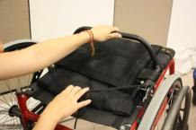




Malfunctioning foldable back supports can be dangerous during transfers.
Inspect the folding mechanism unlatches properly
Inspect the folding mechanism latches properly
Bent pin that does not latch
Wheelchair Maintenance Training: Manual Wheelchair
INSPECT MONTHLY
Maintenance at Home Page 39
Notes:
Explain: Most rigid-frame wheelchairs have a foldable back support for transport and storage.
If you have a folding back support, check that the mechanism lock is in place.
Loose back supports can be dangerous during transfers because they could move or come out.
Always make sure that the back support is locked before using it after unfolding.
If problems are identified contact your wheelchair maintenance expert to get it fixed or replaced.
Demonstrate while describing: If you unfold the backrest frequently be sure that it folds and latches easily.
If you do not unfold it frequently, inspect that the mechanism is working properly monthly.

Slide 40



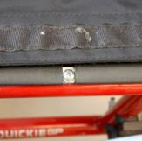
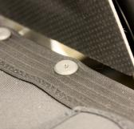
Seat base must be intact because it provides the stable base to the user.
Inspect upholstery condition
Sagging upholstery
Inspect the fasteners
Wheelchair Maintenance Training: Manual Wheelchair
INSPECT MONTHLY
Notes:
Gather: Wheelchair with stretched seat upholstery or wheelchair with solid seat pan.
Explain: Seat bases may either be rigid or an upholstery sling.
In either case, the seat should be stiff and provide a stable support base for the cushion and the user.
Describe while describing: Inspect the seat upholstery/pan for wear, tears, dirt, or metal parts that may be sticking out.
Seat upholstery that is stretched, torn, or more slung in the front should be replaced.
Check all upholstery rivets or screws.
After inspecting remember to put the privacy flap back into place.
If problems are identified, contact a wheelchair maintenance expert to get your upholstery replaced.
Advise: Similar to the backrest upholstery, when the seat upholstery is replaced, it is best to replace the bolts or screws that hold it in place. This will ensure that they are properly maintained as well. Encourage your wheelchair maintenance expert to do so.
For the rigid seat, check that it is intact, no cracks or fractures.
Tighten any loose bolts.
If problems are identified, contact a wheelchair maintenance expert.
This task should be performed monthly.

Slide 41
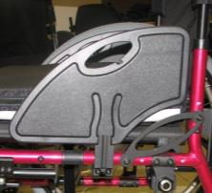
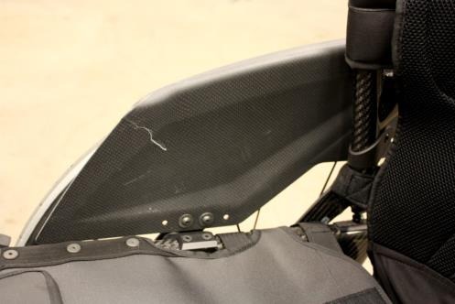
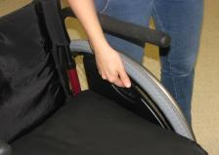
Clothing guard should not have cracks and properly attached.
Inspect it can be removed and put back into place tightly
Cracked clothing guard
Wheelchair Maintenance Training: Manual Wheelchair
INSPECT MONTHLY
Maintenance at Home Page 41
Notes:
Gather: Wheelchair with clothing guards. If possible, use one with cracked and/or loose guards.
Explain: Clothing guards provide a safety barrier between the wheelchair user and the wheel.
They help to protect the clothing from getting caught in the wheels.
Demonstrate while describing: Inspect the clothing guards for cracks and fractures monthly. Inspect that the clothing guards are tight and tighten nuts and bolts as necessary. Use an Allen wrench or screw driver. Contact the wheelchair maintenance expert if problems are identified to get the part replaced.

Slide 42

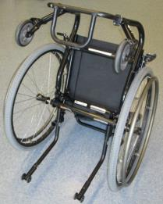
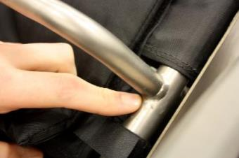
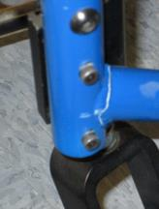
Frames that are cracked, broken or bent can pose a threat to safety and should be tended to immediately.
Inspect the frame
Common weld points
Inspect the weld points
Cracked weld
INSPECT MONTHLY
Maintenance at Home Page 42
Notes:
Gather: Folding frame wheelchair and box frame wheelchair.
Explain: All common wheelchair frames center around tubular construction.
The tubing can either be welded together or bolted together using lugs.
The two basic frame types are folding and rigid, and the two common rigid frame styles are box frame and cantilever frame.
Point out the different frames in participants’ wheelchairs.
Demonstrate while describing: Inspect the frame, weld points, holes and bends to confirm that they are intact.
Look for cracks and fractures as they can result in catastrophic failure of the wheelchair.
This could lead to injury and being stranded.
Ask: What do you do it if you find cracks or fractures in the frame?
Acknowledge participants’ answers
Answer: If cracks and fractures are identified, contact the wheelchair maintenance expert immediately.
This inspection should be performed monthly.

Slide 43
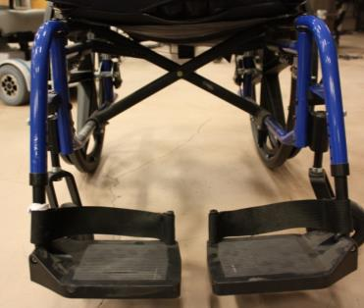
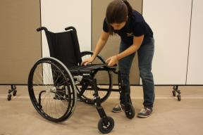
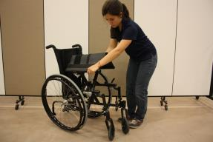

Problems with the folding mechanism may cause the wheelchair to collapse and injury to the user.
Cross brace mechanism
Inspect the folding mechanism functions properly
Wheelchair Maintenance Training: Manual Wheelchair
INSPECT MONTHLY
Maintenance at Home Page 43
Notes:
Gather: Folding frame wheelchair.
Explain: Cross-brace frames allow for the wheelchair to collapse towards the middle for storage.
Demonstrate while describing: Inspect that the cross brace mechanism is working properly every time you use it.
It should open and fold easily.
Note if it is difficult to close or if the wheelchair is unsteady during transfers.
Problems with the cross-brace mechanism may cause the wheelchair to collapse and injury to the user.
If problems are identified, contact a wheelchair maintenance expert.
If you do not fold the wheelchair frequently, this task should be performed monthly.

Slide 44
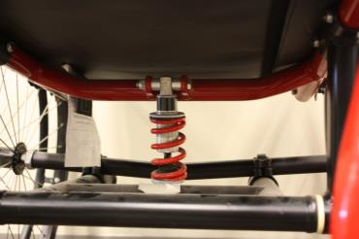


Damaged suspension elements can make the wheelchair harder to drive and less stable when maneuvering obstacles.
Suspension elements
Suspension elements
Damper
Spring
Wheelchair with suspension
Wheelchair Maintenance Training: Manual Wheelchair
INSPECT MONTHLY
Maintenance at Home Page 44
Notes:
Explain: Some frames have built in or “add-on” suspension elements to decrease shock and vibration and make for a smoother ride.
Inspect that the paint in the spring is intact and it has no cracks.
Inspect that the damper is not leaking lubricant.
Point out if there are any participants that have a wheelchair with suspension.
Contact the wheelchair maintenance expert if you find any problems.
Get your suspension professionally inspected if you loose or gain weight significantly.
Inspect the suspension elements monthly.

Slide 45
Caring for a manual wheelchair at home
  Action items: maintenance activities that the wheelchair user or caregiver performs on the wheelchair.
Wheelchair Maintenance Training: Manual Wheelchair
Maintenance at Home Page 45
Notes:
Read the slide

Slide 46
Action Items
Actions to maintain a manual wheelchair
Cleaning your wheelchair | Wheelchair and cushion
 | Caster axle
 | Quick release wheel
Lubricate moving parts
Have wheelchair professionally serviced
Monthly actions
Quarterly actions
Yearly actions
Wheelchair Maintenance Training: Manual Wheelchair
Maintenance at Home Page 46
Notes:
Briefly read the table.
Emphasize red is monthly, green is 4 times per year, and purple once a year.

Slide 47
Pneumatic tires
Monthly Actions

Slide 48





Wipe down the wheelchair frame with a clean, damp rag and soap.
Wipe down the frame with a clean damp rag and soap.
Machine wash
Do not tumble dry
Dry cover on towel away from direct sunlight
When finished, place the cushion back in the correct position
Wheelchair Maintenance Training: Manual Wheelchair
CLEAN MONTHLY
Maintenance at Home Page 48
Notes:
Gather: wheelchair, tweezers, rag and bucket with water
Demonstrate while describing: Wipe down the wheelchair frame with a clean, damp rag and soap.
Emphasize: the rag should be moist and not soaked.
Remove any fabric covers from the frame and the calf straps if possible.
Cleaning the wheelchair may stop metal parts from rusting and may stop damage caused by dirt scraping against moving parts.
Note that taking the wheel off makes cleaning that side of the frame easier.
Take the cushion cover off if possible and wash in the washer.
Emphasize do not machine dry the cover.
The fabric may shrink and not fit the cushion anymore. Instead, dry over a towel preferable overnight and indoors/in the shade, avoiding direct sunlight.
Be sure to put the cover back on the cushion in the correct orientation.
Refer to the cushion user guide for cushion washing instructions.
Dirt on the cushion can cause skin breakdown.
Dirt can cause odor on both the wheelchair and cushion.
Ask: How often do you clean your wheelchair and cushion?
Acknowledge answers
This task should be performed monthly, or twice a month if you are in inclement weather

Slide 49



Clean caster axels, hair especially can twist around the bearings and cause breakage.
Cleaning the casters
Dirt and hair removed from a caster
Wheelchair Maintenance Training: Manual Wheelchair
CLEAN MONTHLY
Maintenance at Home Page 49
Notes:
Gather: wheelchair, scissors and toothbrush and plyers
Demonstrate as you describe: Remove dirt, lint, and hair from the caster axles bearings with scissors, tweezers, toothbrush, or plyers.
Dirt, lint, or hair buildup on the axles and casters can eventually cause premature wear.
Hair especially can twist around the bearings and cause breakage.
Ask: how often do you clean your caster axles?
Acknowledge answers
Dirt and lint should be removed monthly, or twice a month if you are in inclement weather or have pets.

Slide 50





Clean the quick-release wheel-axle housing.
Clean and lubricate the axle in the quick-release mechanism
Clean the axle receiver
Wheelchair Maintenance Training: Manual Wheelchair
CLEAN MONTHLY
Maintenance at Home Page 50
Notes:
Gather: A wheelchair with quick release wheels, rag and wd40
Increased friction between moving parts can accelerate wear of the parts.
Describe while demonstrating: Remove the quick-release wheel.
Clean the axle and the wheel housing with a rag dampened with WD40, then lubricate them with the same spray and then wipe off the extra.
Also, try and clean the axle housings and around the bearings.
This task should be performed monthly.

Slide 51
Pneumatic tires
Quarterly Actions

Slide 52




Lubricate moving parts: increased friction between moving parts can accelerate wear of the parts.
Lubricating the caster stem
Lubricating a folding backrest
DO NOT lubricate sealed bearings
Wheelchair Maintenance Training: Manual Wheelchair
LUBRICATE 4 TIMES/YEAR
Maintenance at Home Page 52
Notes:
Gather: Rag and WD40 or similar lubricant.
Explain: Each wheelchair model will have different moving parts that should be lubricated. Increased friction between moving parts can accelerate wear of the parts.
Demonstrate while explaining: Clean, dry, and apply lubricating oil or Teflon-based spray to all moving parts, including the folding mechanism, where the front casters turn, and exposed hinges. Use a rag to remove excess lubricant.
Example of lubricating oil: Liquid wrench, 3M multipurpose lubricant
Example of teflon-based oil: Tri-Flow Lubricant ,TeflonTM
DO NOT lubricate sealed bearings!
DO NOT use penetrating oil!
Point out all the moving parts in the wheelchair. Emphasize which ones can be lubricated (e.g. at the top of the caster fork and caster stem ) and which ones not (e.g. caster axle)
This task should be performed four times a year.

Slide 53
Pneumatic tires
Yearly Actions

Slide 54

Have the wheelchair professionally serviced
All wheelchairs should be professionally serviced at least
once a year.
In places with inclement weather conditions, wheelchairs should be professionally serviced twice a year.
Wheelchair Maintenance Training: Manual Wheelchair
Maintenance at Home Page 54
Notes:
Read the slide

Slide 55
Learning Objectives
Recognize the importance of completing wheelchair maintenance
List the appropriate timing for wheelchair maintenance tasks
Demonstrate methods for maintaining your wheelchair
Demonstrate how to identify common technical wheelchair problems
Wheelchair Maintenance Training
Summary/homework Page 55
Notes:
Remind participants today we recognized the importance of wheelchair maintenance.
Also, we reviewed each maintenance task and how frequent it should be performed.

Slide 56
Thank you!
See you next class
Notes:
Inquire if there are any unsolved questions.
Acknowledge them and answer.
If there are unsolved questions, search and prepare the answers for the second session.
Remind the participants: We will keep the toolkit and maintenance cards until next session. You can take them home next session.

Slide 57
Manual Wheelchair User Maintenance Training
Day 2
Notes:
Welcome the wheelchair users and thank them for participating in this training program.
Remind participants your name and your co-trainer’s name if you have one.
Answer any unsolved questions from the first session before starting.
Hand out toolkits and maintenance cards.

Slide 58
Day | Duration (minutes) | Time | Activity
2 | 90 |  | Hands-on wheelchair maintenance activity
 | 20 |  | Summary and discussion
 | 5 |  | Adjournment
Wheelchair Maintenance Training
Agenda Page 58
Notes:
Read the activities that will happen during this training session.

Slide 59
Hands-on wheelchair activity
Bring your maintenance checklist and toolkit
If you identify maintenance issues on your wheelchairs, write them down on hands-on activity sheet
You will have 90 minutes to perform this activity
Let us know if you have questions or need assistance
Wheelchair Maintenance Training
Hands-on 2 Page 59
Notes:
Gather:
1 bucket with water and mild soap for every pair of participants
1 rag per participant
Form pairs between the participants. Try to pair up participants with different personalities, for example, a more talkative one with a more shy participant.
Explain each one of you will perform the maintenance on your own wheelchair.
I will pair you up so you can perform the maintenance at the same time and support each other if needed.
If you prefer, you can practice the skills on the demo wheelchair that I have used through the training.
We (you and the aids) will walk around the room and provide any assistance and answer questions as needed.

Slide 60

Hands-on wheelchair activity
REMEMBER TO CHECK NUTS AND BOLTS ON ALL THE PARTS THAT APPLY
Notes:
Gather: a checklist per participant and at least an erasable marker per pair.
Explain: We will perform the inspection and action items. Please follow the order on the laminated checklist that we have provided. Use the marker to check the activities that you have done. If your wheelchair does not have a part, check the box under mark if not applicable. We will have up to one hour and a half.
Let’s start with the weekly inspections.
Keep track of time, there are maximum 90 minutes for this portion of the session.
Continue to cue the participants so they change from one activity to the next one and they do not fall behind.
Leave this slide up while you monitor participants work.
Once all participants have completed the weekly inspections, click to the next slide.
Note questions than participants have and share them with all the participants on the next session.

Slide 61

Hands-on wheelchair activity
REMEMBER TO CHECK NUTS AND BOLTS ON ALL THE PARTS THAT APPLY
Notes:
Explain: Now we will practice the inspection and action items that we recommend you do monthly.
Continue to cue the participants so they change from one activity to the next one and they don’t fall behind.
Remember that you have maximum 90 minutes for the hands-on activity.
Leave this slide up while you monitor participants work.
Once all participants have completed the monthly inspections and actions, click to the next slide.
Note questions that participants have and share them with all the participants on the next session.

Slide 62
Hands-on wheelchair activity
REMEMBER TO CHECK NUTS AND BOLTS ON ALL THE PARTS THAT APPLY
Notes:
Explain: Now we practice lubricating moving parts which we recommend you do every three months.
Remember to wipe the lubricant thoroughly so it does not collect dust and debris.
Leave this slide up while you monitor participants work.
Once all participants have completed lubricating, explain: Remember that we recommend that you have your wheelchair professionally serviced at least once a year.
Note questions than participants have and share them with all the participants on the next session.

Slide 63
Summary and discussion
Wheelchair Maintenance Training
Summary/discussion Page 63
Notes:
Summarize the questions that were raised during the hands-on activity.
Ask the questions to the participants and acknowledge the answers.
Clarify confusing points.
Ask the less talkative participant from each pair to share with the group what up to two problems that were identified and how to address them (hint: they should have written them down in the hands-on activity sheet).
Explain we will summarize all the inspection activities we learned and practice during this two sessions.
Invite participants to follow your summary using the maintenance cards.
Encourage participants to ask any additional questions that they think remains unanswered.

Slide 64
Weekly
Inspection
Pneumatic tires
Cushion and cover
Maximum estimated time: 30 minutes
Notes:
Read the slide

Slide 65
Monthly
Inspection
Wheel locks
Supports alignment and function
Wheels and casters condition and function
Spokes
Upholstery
Frame
Action
Wipe down wheelchair and cushion
Clean caster axle
Clean quick release wheel axle housing
Nuts and bolts
Maximum estimated time: 60minutes
Notes:
Read the slide and emphasize that nuts and bolts should be inspected on all the items listed here.

Slide 66
Every three months
Action
- Lubricate moving parts
Maximum estimated time: 15 minutes
Notes:
Read the slide

Slide 67
Yearly
Action
- Have wheelchair professionally serviced
Estimated time: 60 minutes
Notes:
Read the slide

Slide 68
Learning objectives
Recognize the importance of completing wheelchair maintenance
List the appropriate timing for wheelchair maintenance tasks
Demonstrate methods for maintaining your wheelchair
Demonstrate how to identify common technical wheelchair problems
Notes:
Explain: Briefly describe how the learning objectives mentioned at the beginning of the first session have been met.

Slide 69

Reminders
Wheelchair Maintenance Training
Summary/homework Page 69
Notes:
Explain that as part of their participation in the study, they will receive 3 reminders throughout the year.
They can chose up to 2 format of reminders.
Read the slide.
Ask participants to fill out the reminder sheet,

Slide 70
Reminders
Remember that regular maintenance is important for your wheelchair to perform properly. Review the maintenance cards that you received in your toolkit and be sure that you are following the directions in a timely manner. If you are in need of a repair, remember to contact a wheelchair maintenance expert.
Wheelchair Maintenance Training: Manual Wheelchair
Summary/homework Page 70
Notes:
Read the information the participants will receive in the reminder.

Slide 71
Remember you have with you
  Maintenance cards
  Toolkit
  Reminders
    Every 3 months for 1 year
Wheelchair Maintenance Training
Summary/discussion Page 71
Notes:
List and show the resources that the wheelchair users are taking home.

Slide 72
Thank you!
Don’t forget your resources
Wheelchair Maintenance Training

Slide 73
References
Berg K, Hines M, Allen S. Wheelchair users at home: few home modifications and many injurious falls. Am.J.Public Health 2002;48.
Calder CJ, Kirby RL. Fatal wheelchair-related accidents in the United States. Am.J.Phys.Med.Rehabil. 1990;184-90.
Chen WY, Jang Y, Wang JD, Huang WN, Chang CC, Mao HF, Wang YH. Wheelchair related accidents: relationship with wheelchair-using behavior in active community wheelchair users. Arch.Phys.Med.Rehabil. 2011;892-8.
Gaal RP, Rebholtz N, Hotchkiss RD, Pfaelzer PF. Wheelchair rider injuries: causes and consequences for wheelchair design and selection. J.Rehabil.Res.Dev. 1997;58-71.
Hansen R, Tresse S, Gunnarsson RK. Fewer accidents and better maintenance with active wheelchair check-ups: a randomized controlled clinical trial. Clin.Rehabil. 2004;631-9.
Kirby RL, Ackroyd-Stolarz SA, Brown MG, Kirkland SA, MacLeod DA. Wheelchair-related accidents caused by tips and falls among noninstitutionalized users of manually propelled wheelchairs in Nova Scotia. Am.J.Phys.Med.Rehabil. 1994;319-30.
Notes:
Point out that these are the main scientific article references.
Be willing to forward the copies of the articles if wheelchair users are interested.

Slide 74
References
McClure LA, Boninger ML, Oyster ML, Williams S, Houlihan B, Lieberman JA,Cooper RA. Wheelchair repairs, breakdown, and adverse consequences for people with traumatic spinal cord injury. Arch.Phys.Med.Rehabil. 2009;2034-8.
Nelson AL, Groer S, Palacios P, Mitchell D, Sabharwal S, Kirby RL, Gavin-Dreschnack D, Powell-Cope G. Wheelchair-related falls in veterans with spinal cord injury residing in the community: a prospective cohort study. Arch.Phys.Med.Rehabil. 2010;1166-73.
Wang H, Liu HY, Pearlman J, Cooper R, Jefferds A, Connor S, Cooper RA. Relationship between wheelchair durability and wheelchair type and years of test. Disabil.Rehabil.Assist.Technol. 2010;318-22.
World Health Organization. (Accessed 2013, May 8). Trainers Manual for Wheelchair Service Training Package: Basic Level [Online]. Available:
http://www.who.int/disabilities/technology/wheelchairpackage/en/
World Health Organization. (Accessed 2013, May 8). Reference Manual for Participants [Online]. Available:
http://www.who.int/disabilities/technology/wheelchairpackage/en/
Worobey L, Oyster ML, Nemunaitis G, Cooper R.A., Boninger M.L. Increases in Wheelchair Repairs, Breakdown, and Adverse Consequences for People with traumatic Spinal Cord Injury. Am.J.Phys. Med.Rehab.2012;463-9;.

